Slide 1
Room Digital Counter
Team Members:
Seungyeon Lee
Jamy Salas
Minyoung Kim

Slide 2
EDUCATION FIELD
Problem
Avoiding crowded spaces at school since COVID-19 hit
Solution
We design a program that will limit the number of people entering a room.

Slide 3
What Software we used:
Quartus ii.
"DE1-SoC System Builder"
USB blaster ii driver.
FPGA Tutorial - setting up SOPC builder

Slide 4
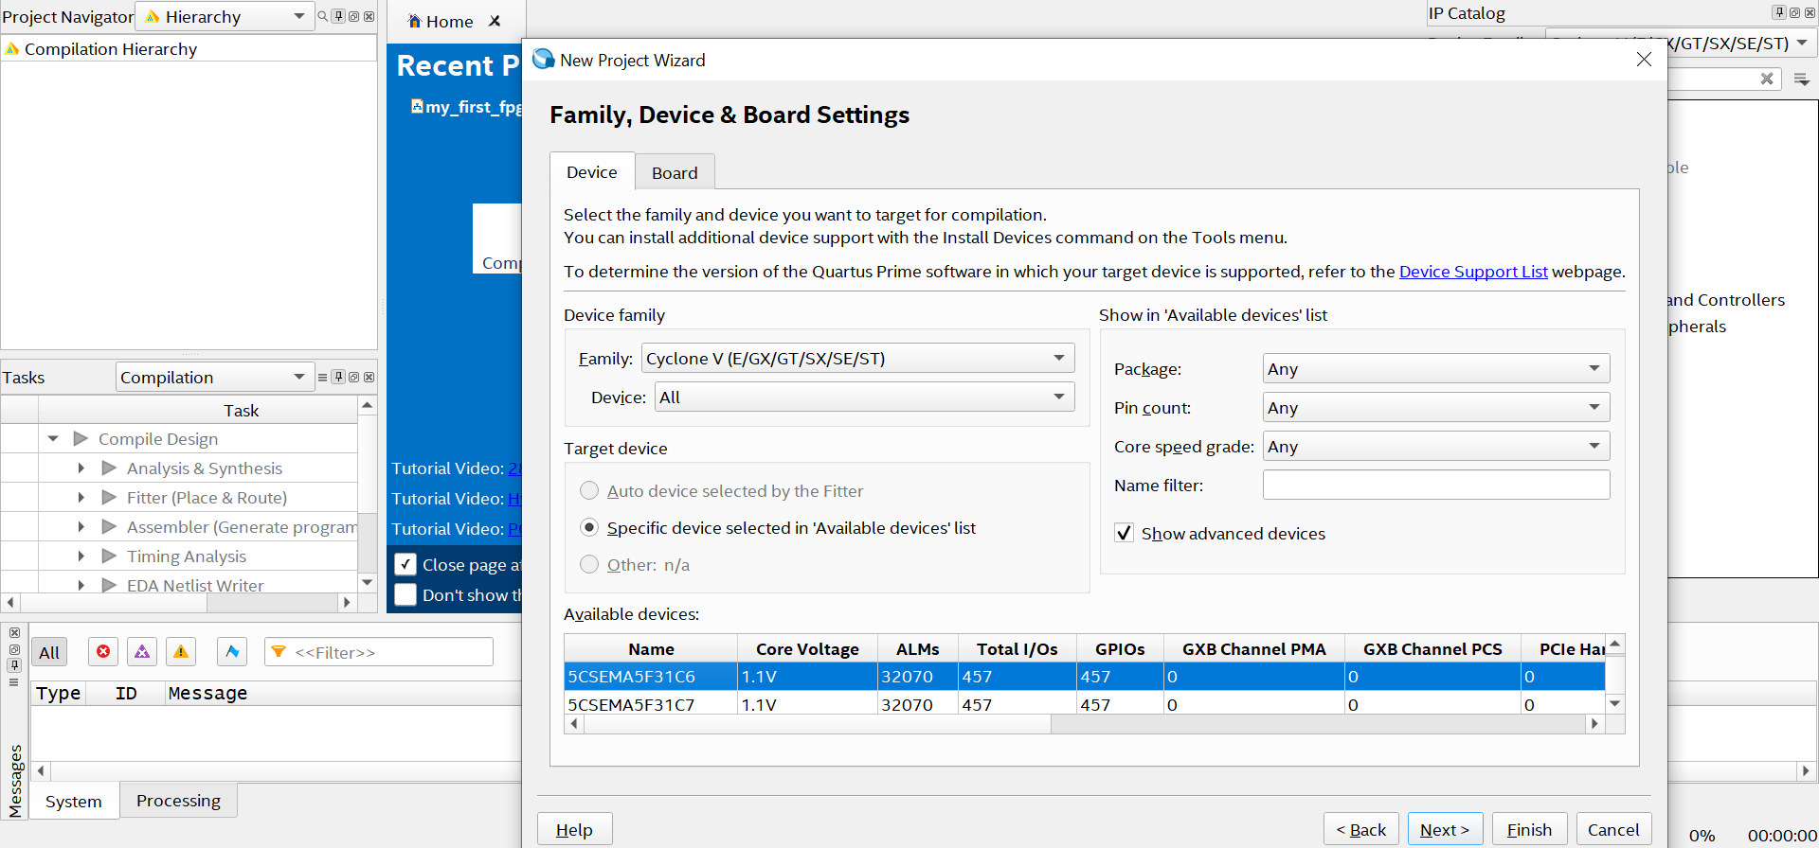
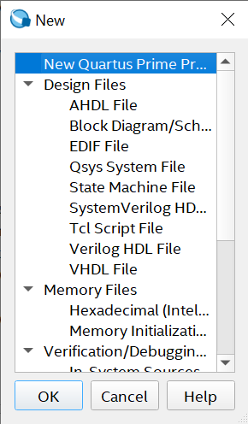
Verilog program coding

Slide 5
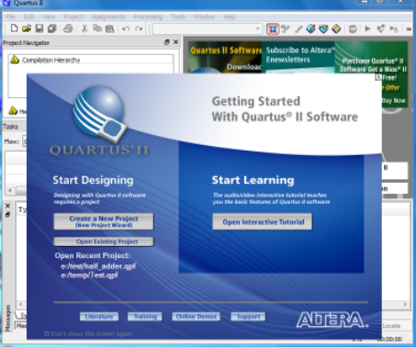
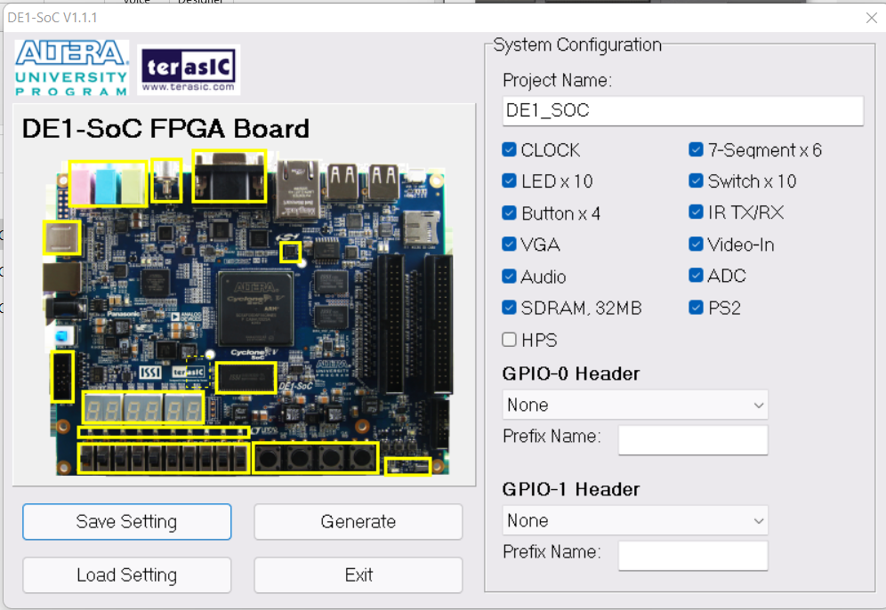
Program download to FPGA device
Quartus ii
It’s a programmable device design software that enables the analysis and synthesis of HDL designs. We used it to write our code.
"DE1-SoC System Builder"

Slide 6
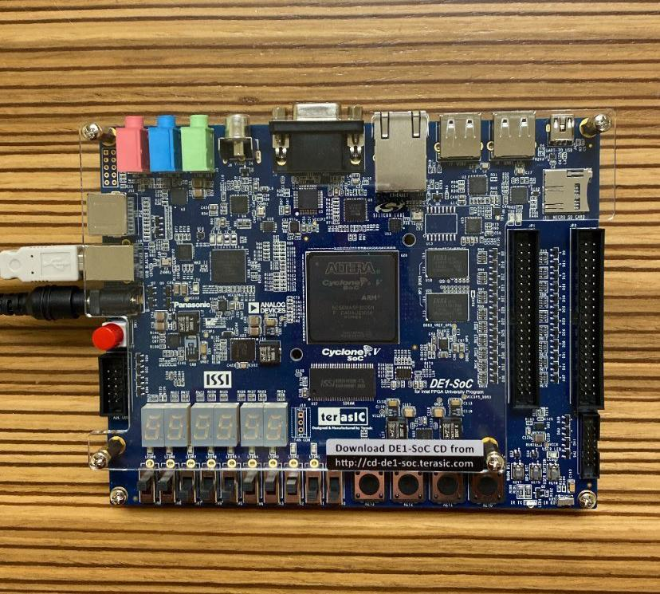
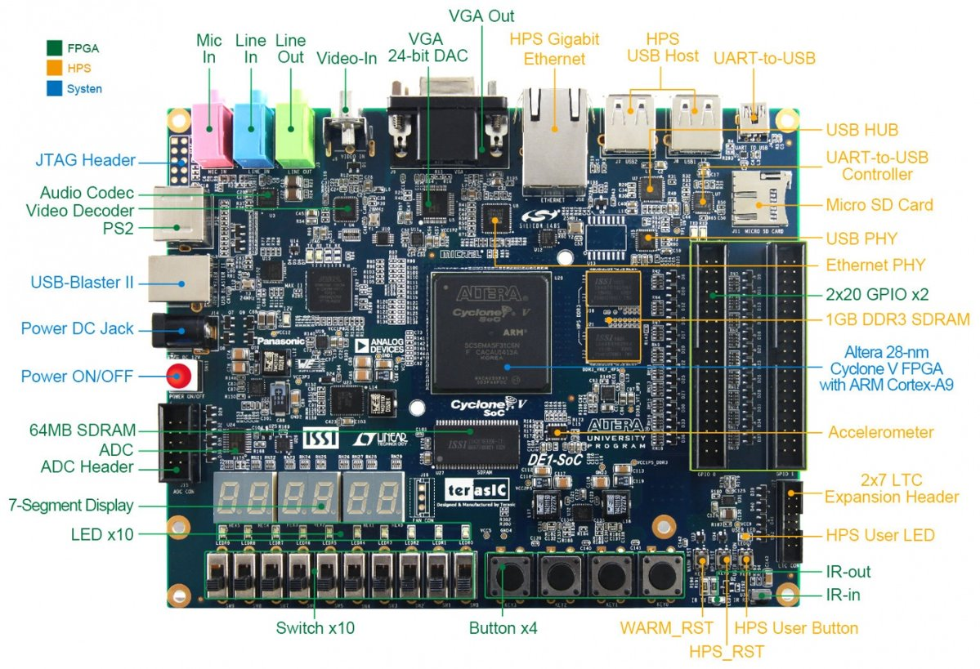
DE1-SOC FPGA device

Slide 7
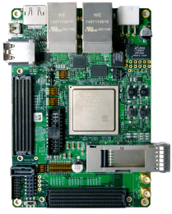
ARM processing chip
ARM is a Reduced Instruction Set Computing (RISC) processor used in personal computers since the 1980s.

Slide 8
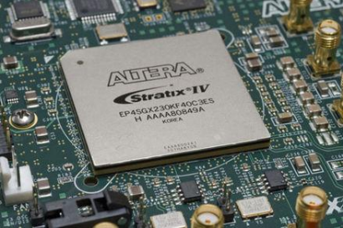
Field Programmable Gate Arrays (FPGAs)
It is a direct circuit designed for configuration after manufacturing.
It is determined using HDL (Hardware Description Language).

Slide 9
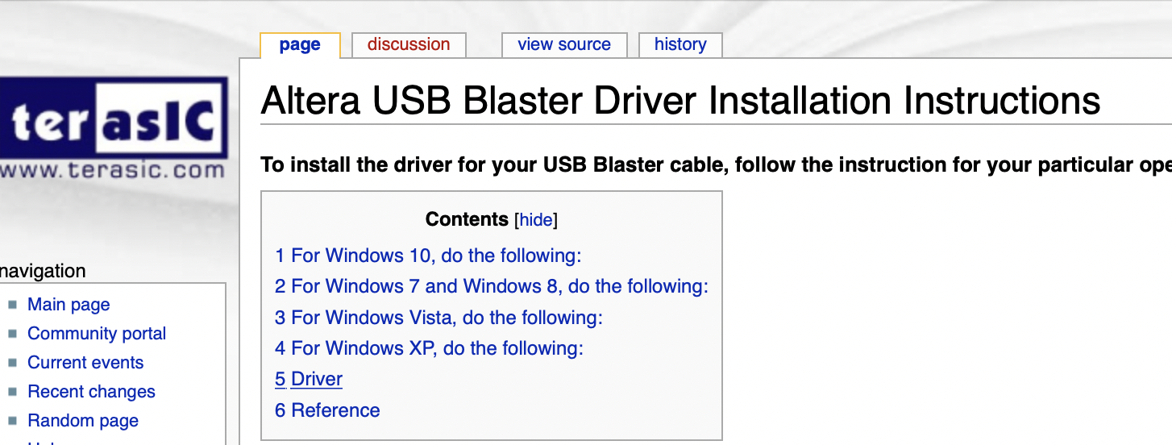
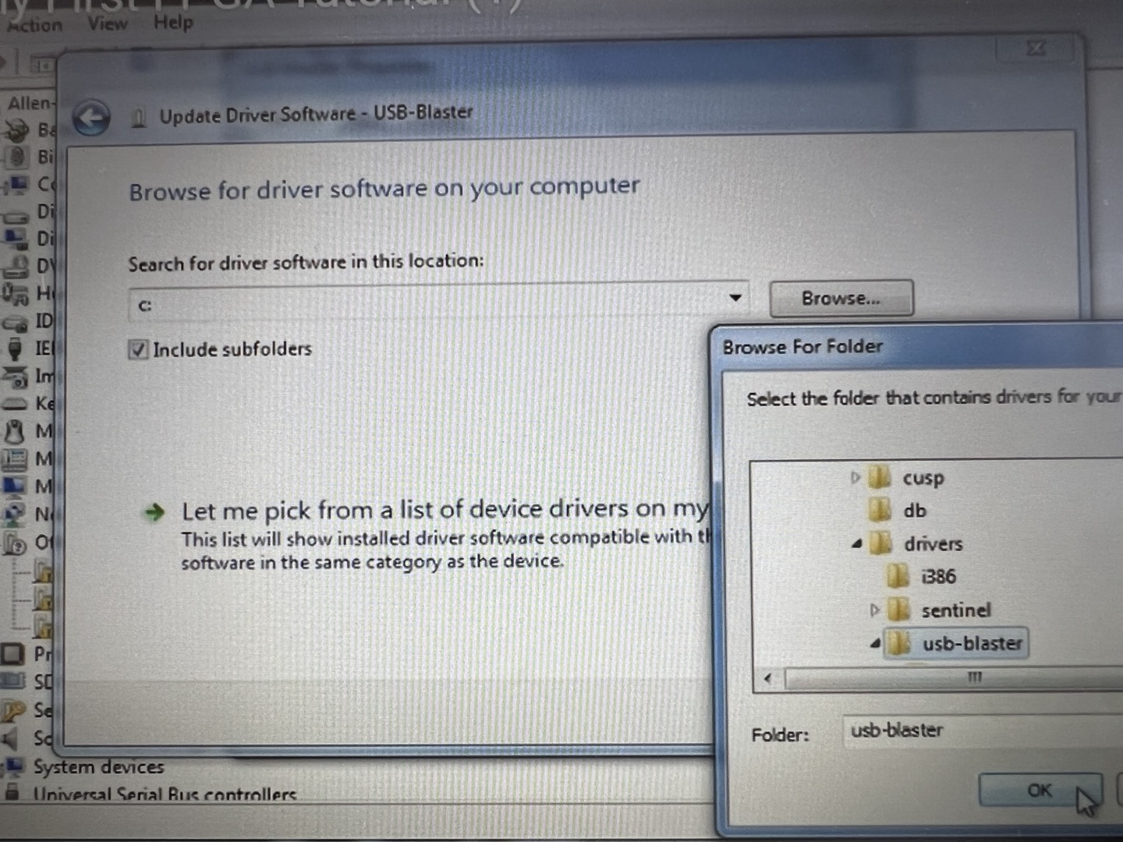
USB Blaster download
First, download the USB Blaster in the terasic site
USB blaster that downloaded is found in the Device manager

Slide 10
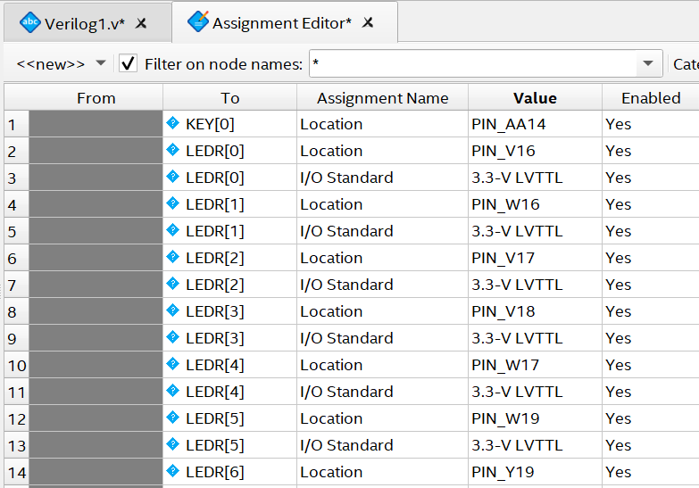
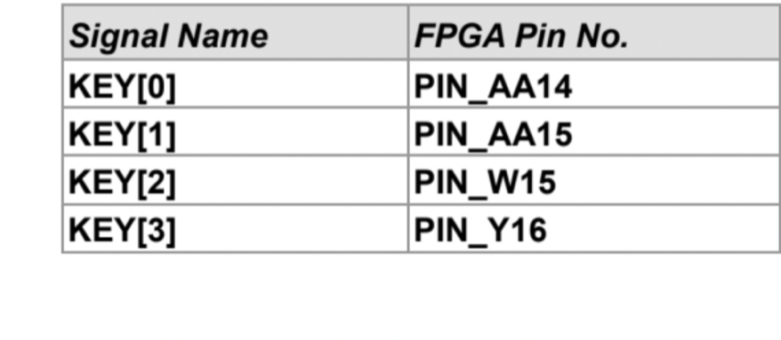
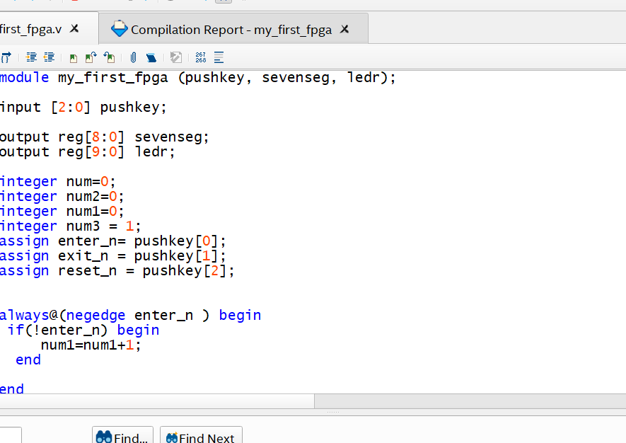
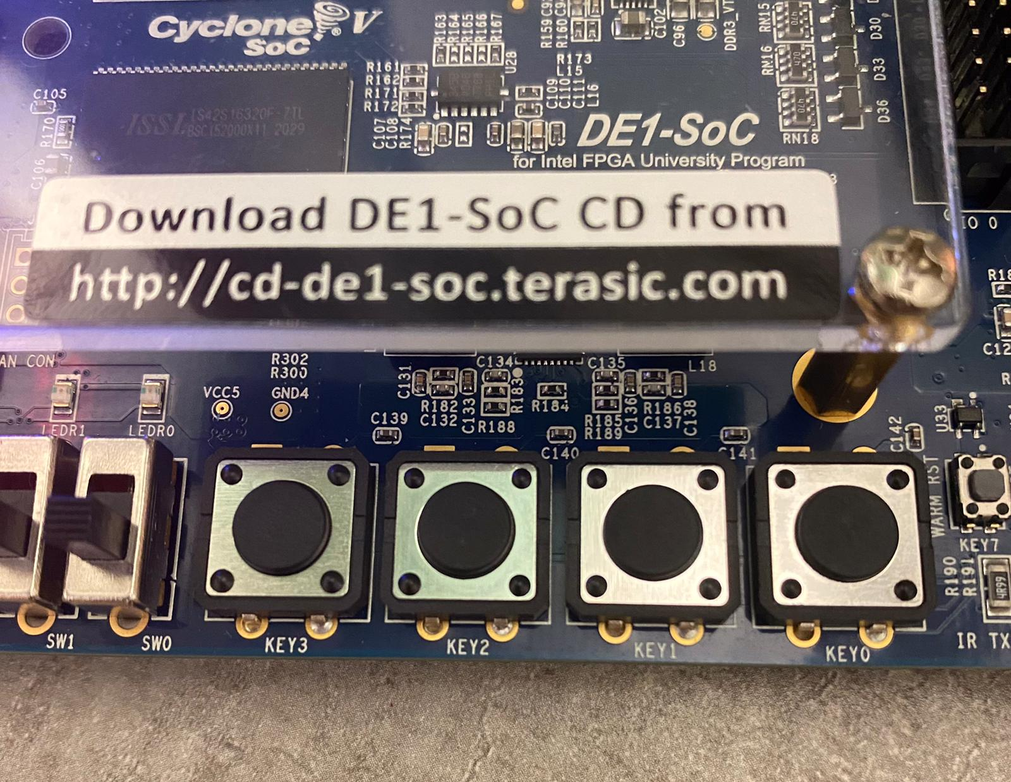
Setting the KEY and LED

Slide 11
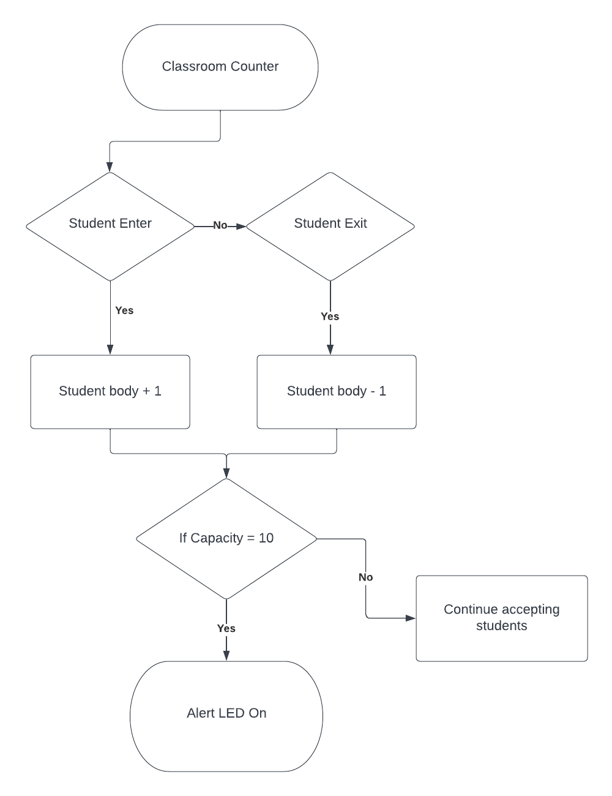
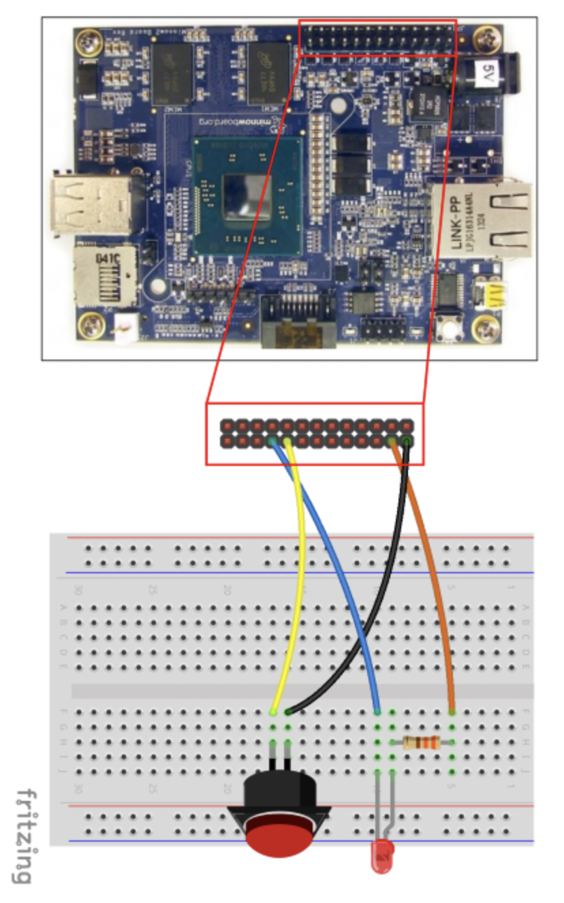
Edge Detection and Flow chart
Falling and rising edges
Connecting the LED which looks number
Pressing the KEY[0],[1],and [2]
Pressed KEY makes pulse
If [KEY0] is pressed, the number of board goes up.
If [KEY1] is pressed, the number of board goes down.

Slide 12
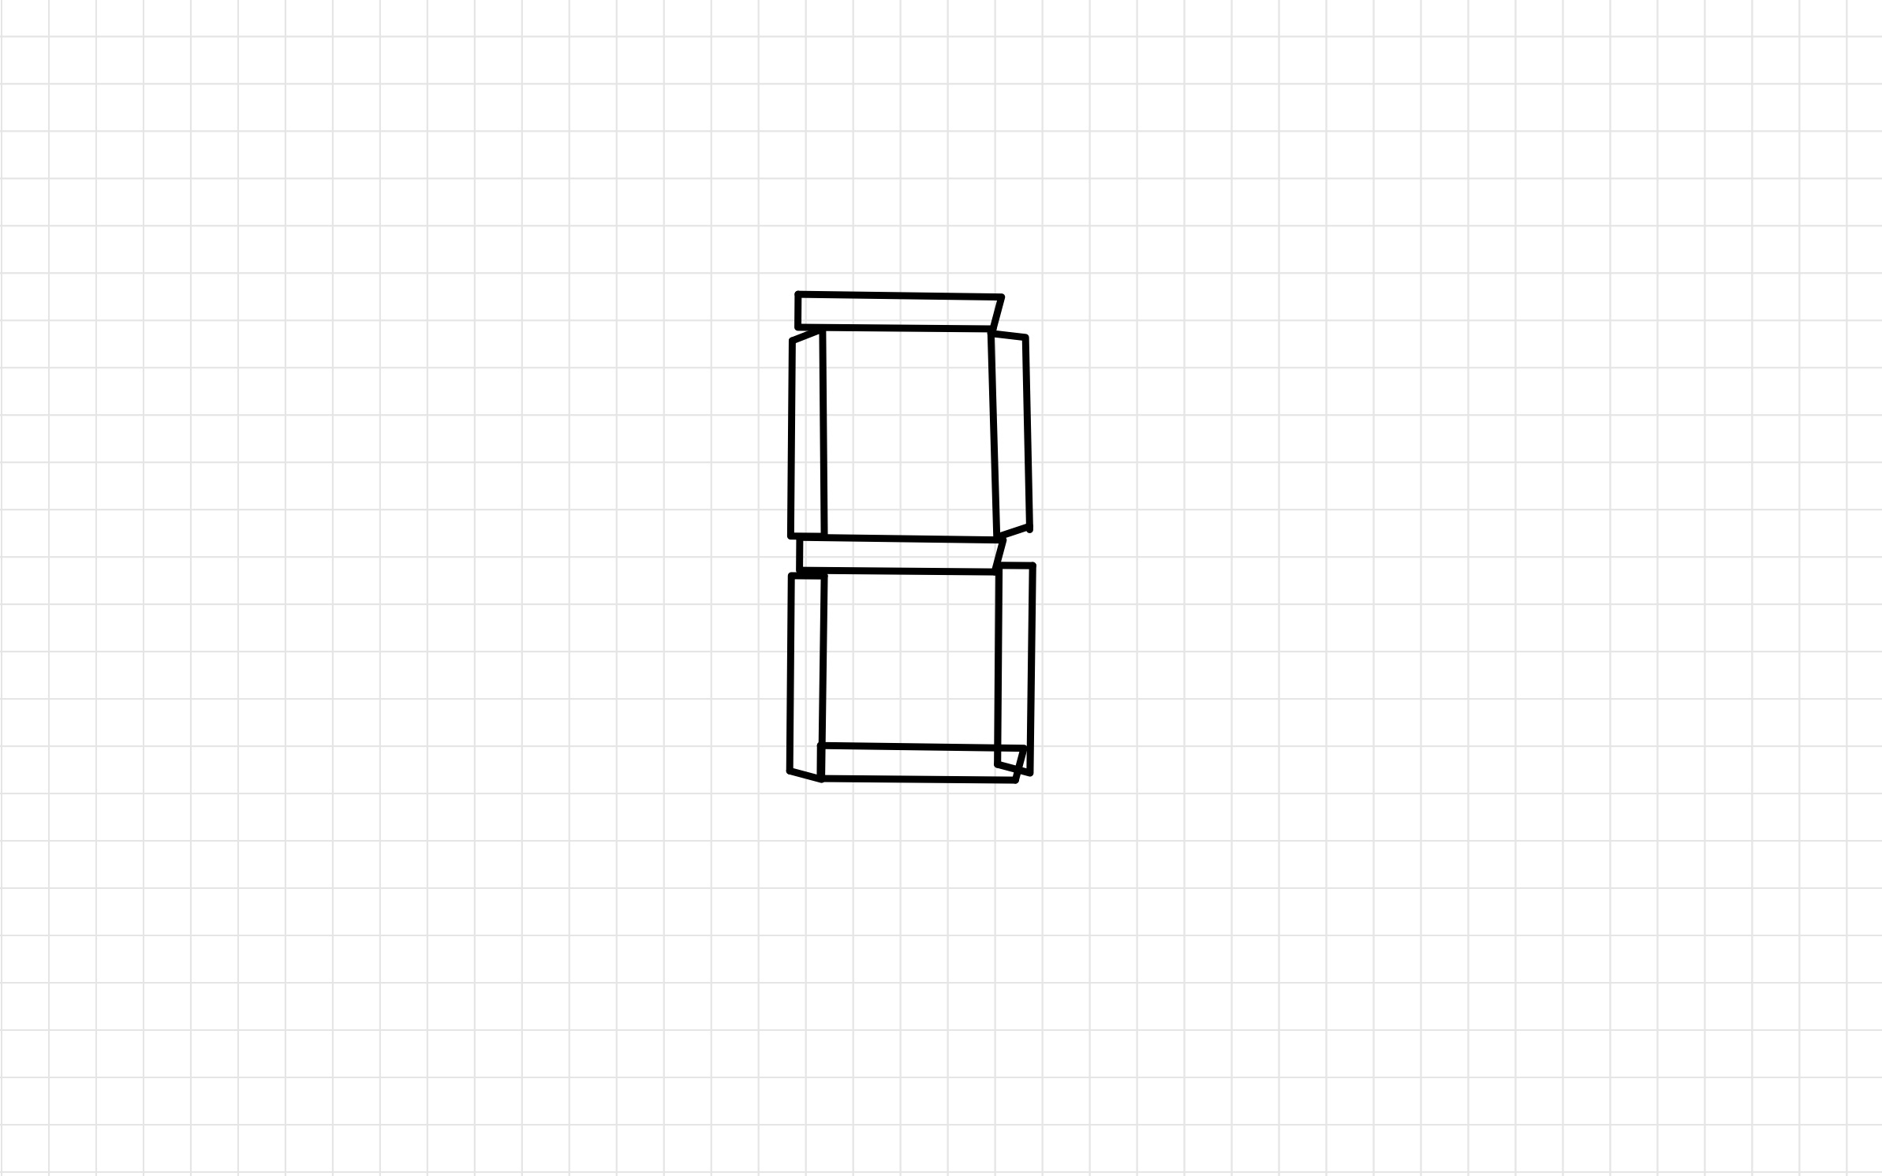
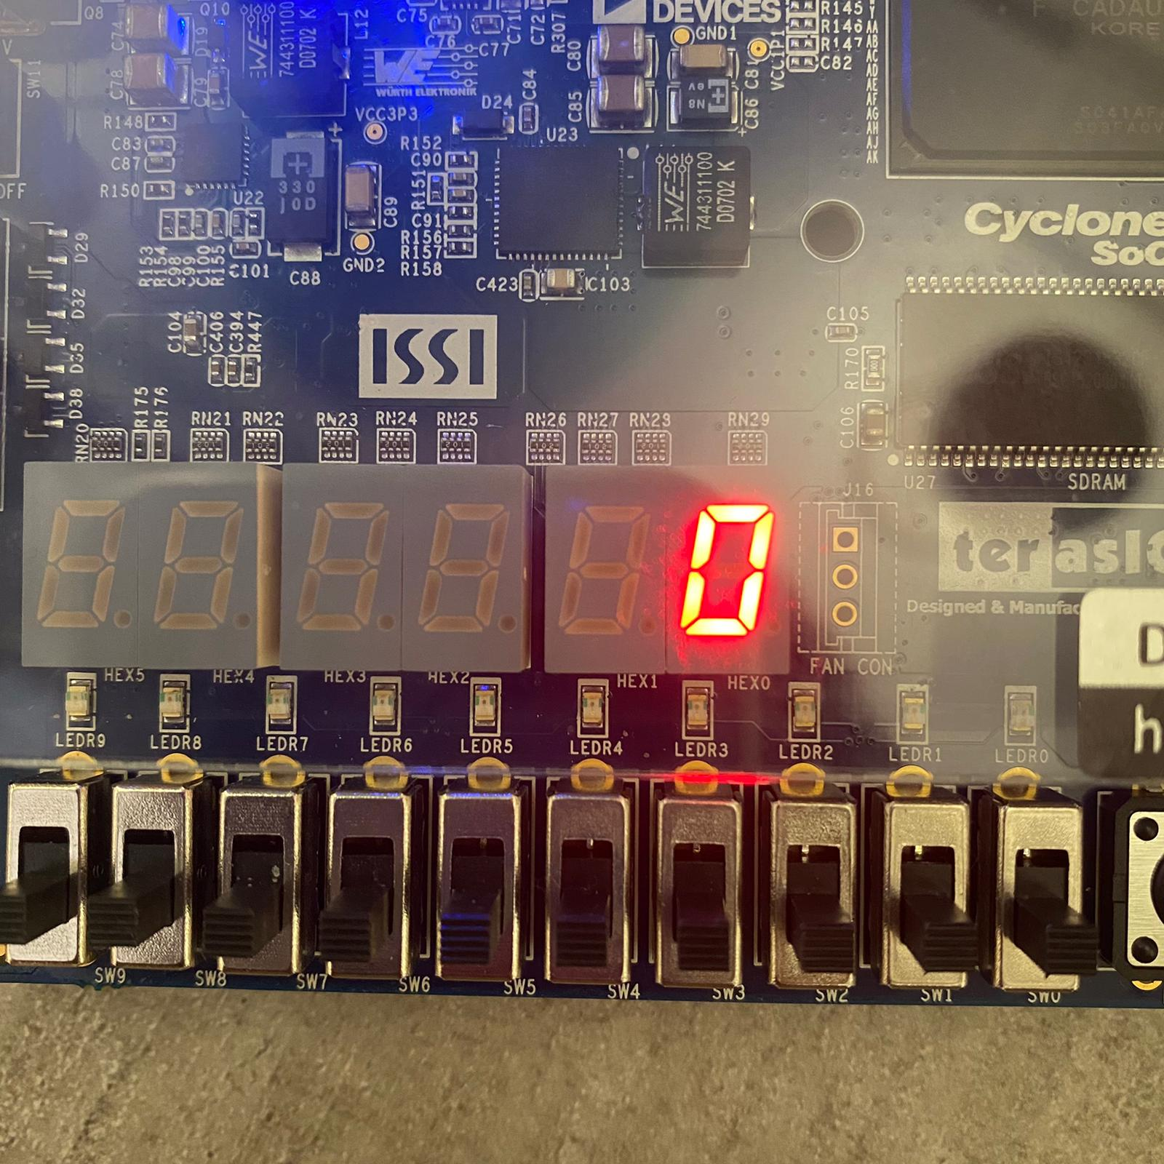



LED have 7 Segments
0
5
1
6
4
2
3
Using 7 segments, we can express the number from 0 to 9.

Slide 13
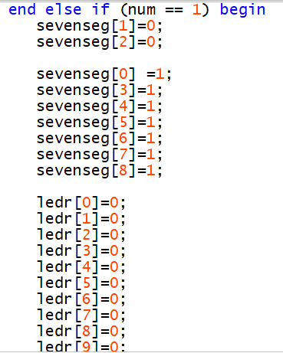
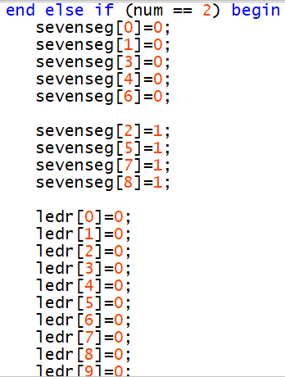
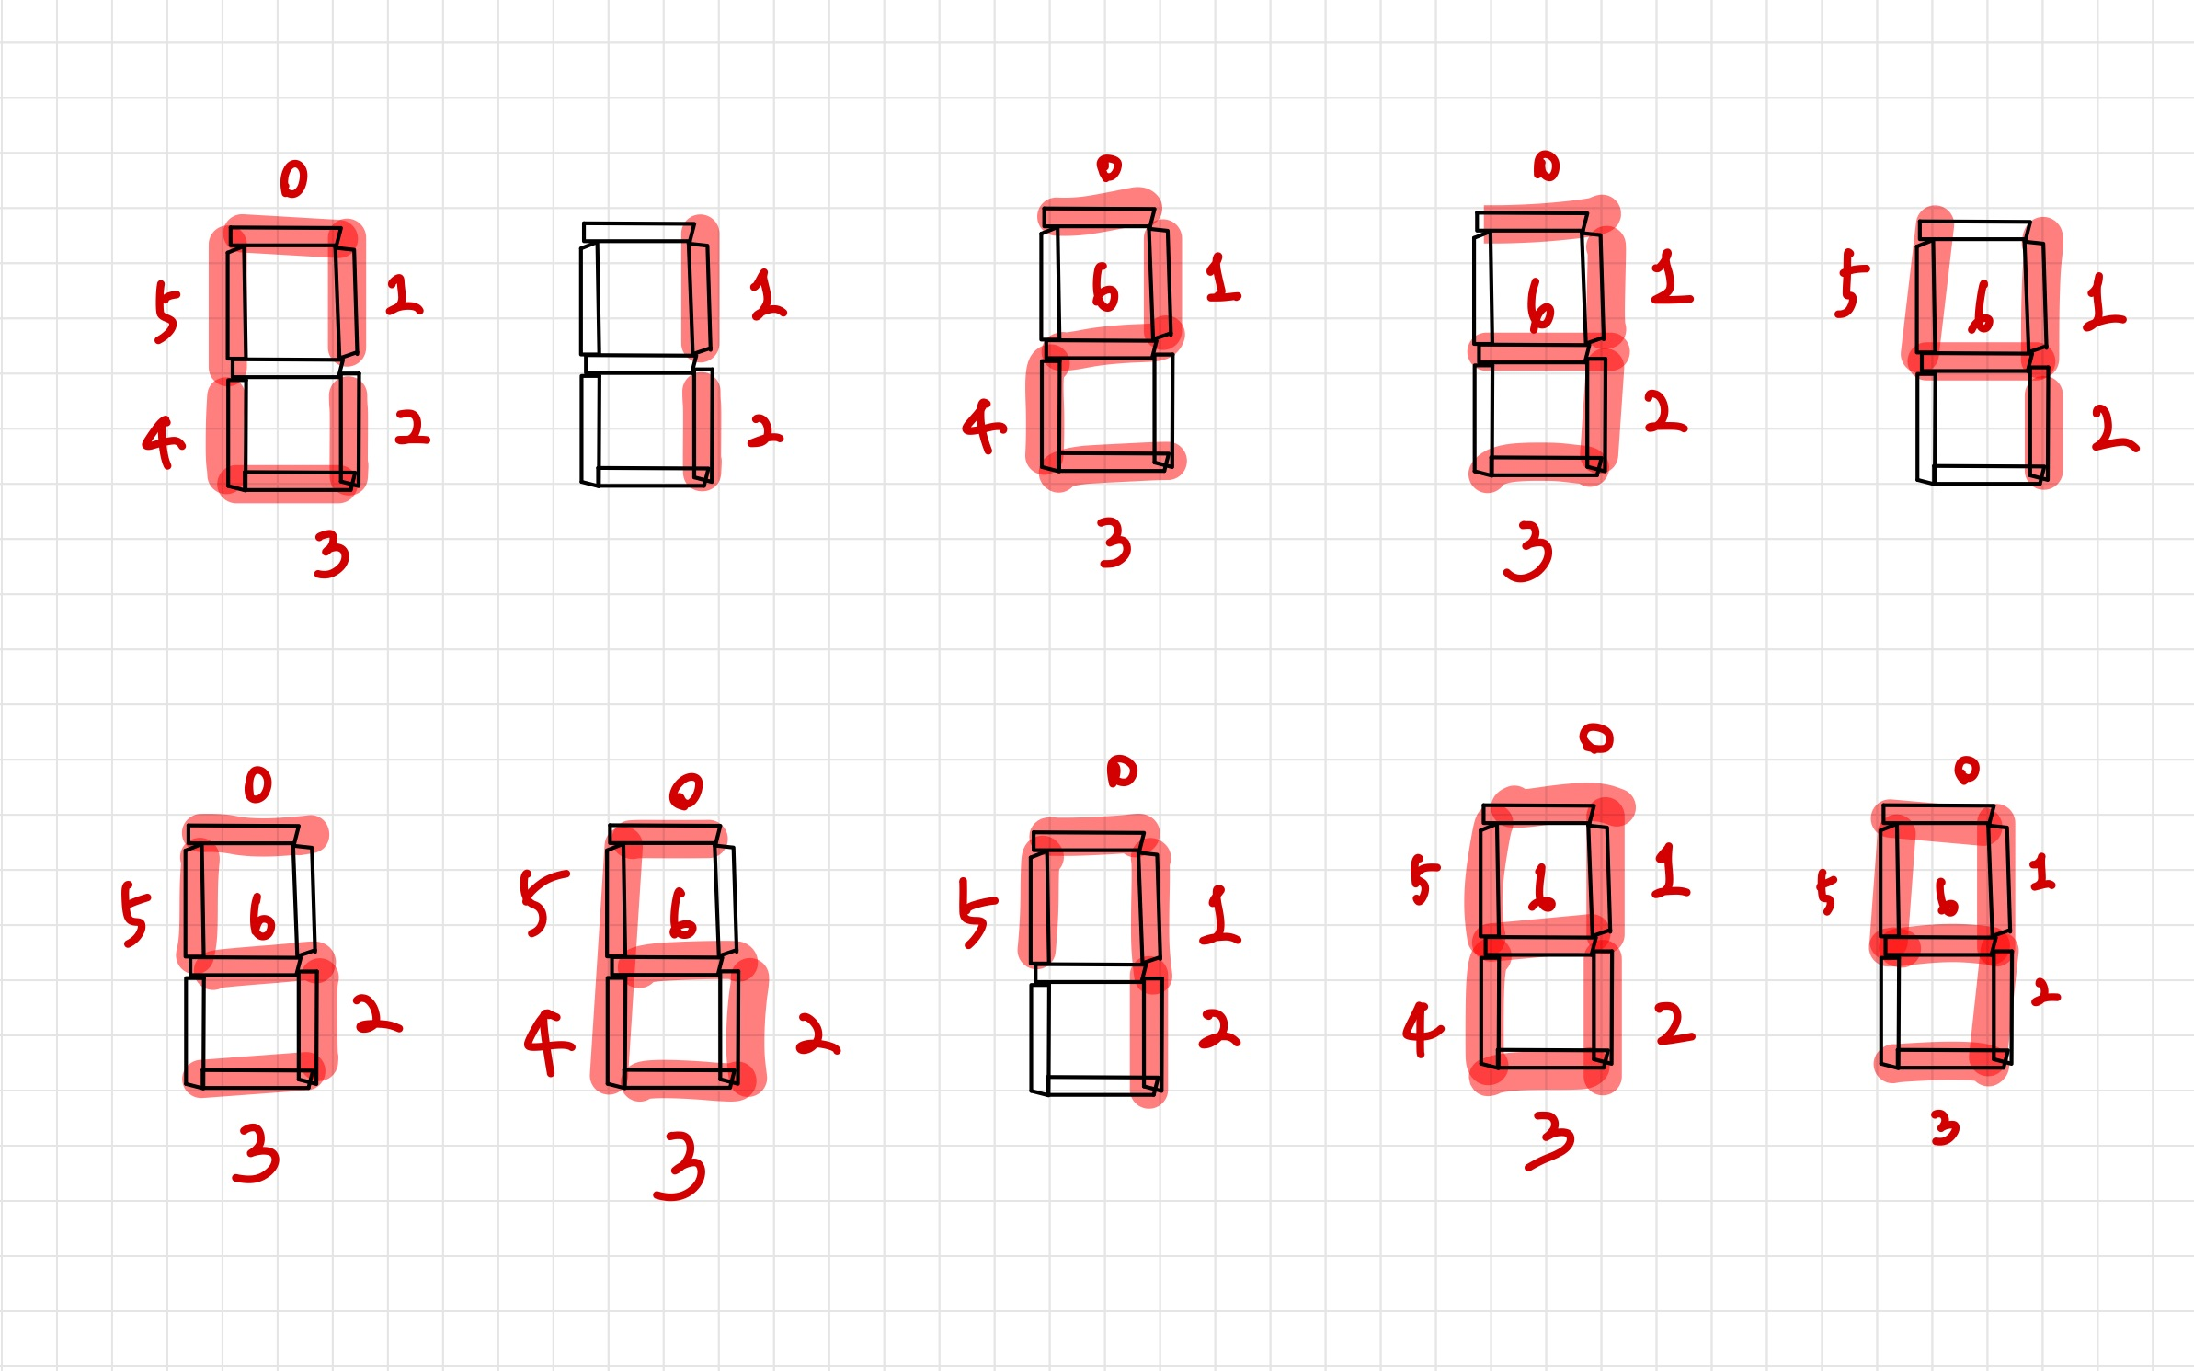

Slide 15
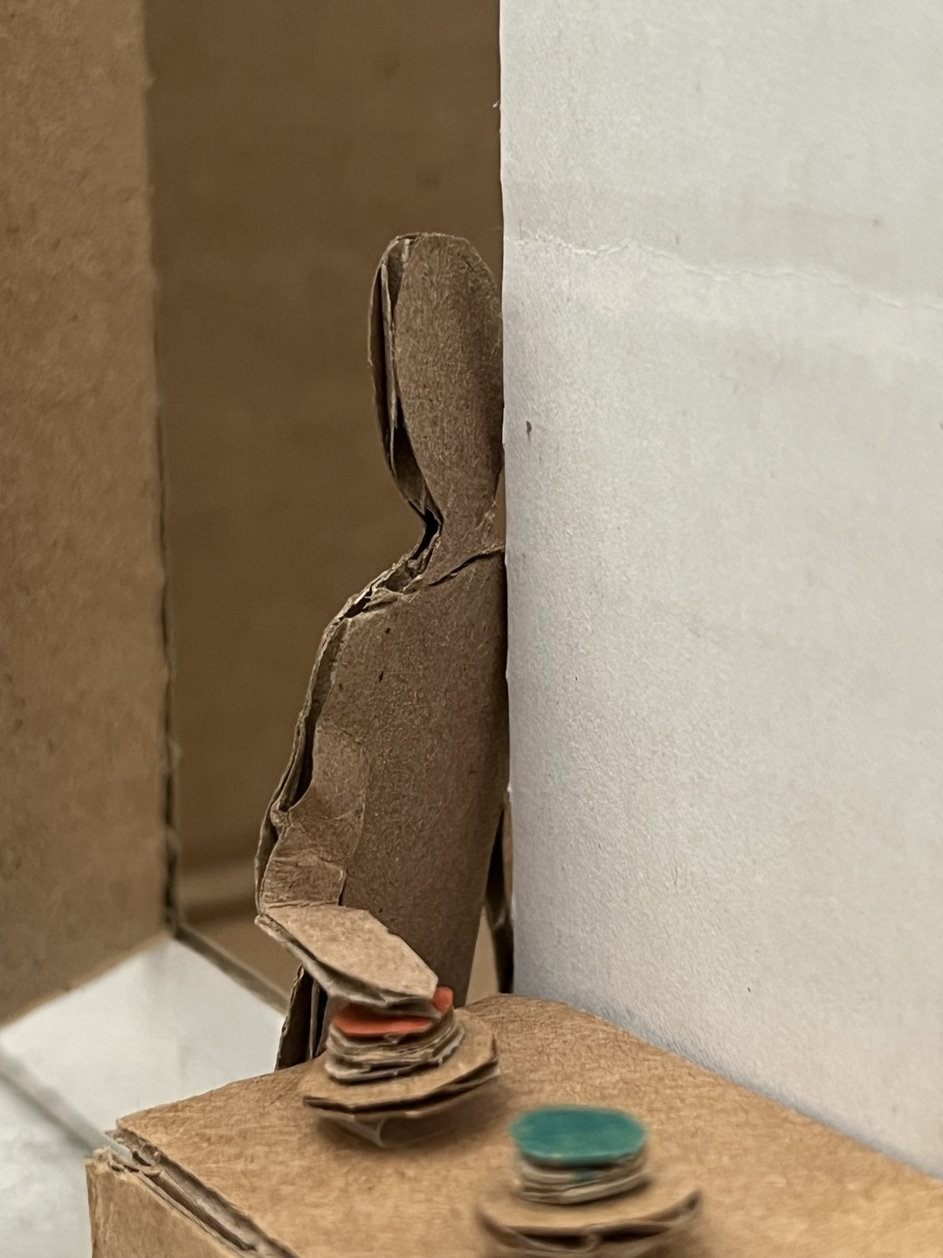
The rules of Room Digital Counter
Using three keys; [KEY0], [KEY1], [KEY2]
When someone enter the room, red button (=[KEY0]) is pressed.
When someone go out from the room, bule button (=[KEY1]) is pressed.
At the same time, it can be shown physical number using 7 segments.
The number of people is counted by pressing the buttons.

Slide 16
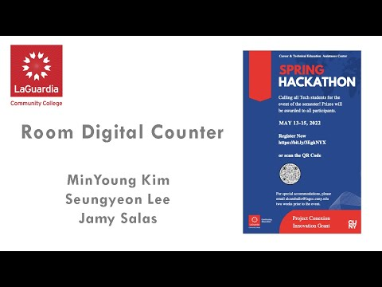
Final Scenario Video

